Slide 1
WaveNet: A Generative Model for Raw Audio

Slide 2
Chalange

Slide 3
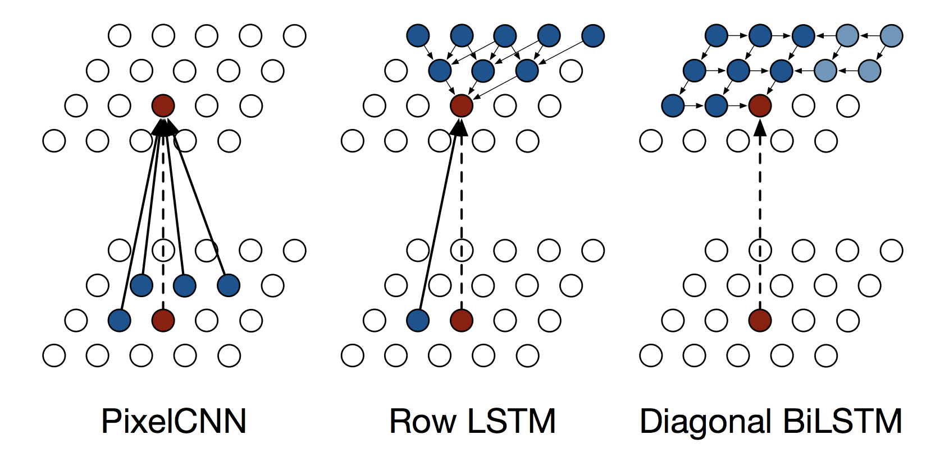
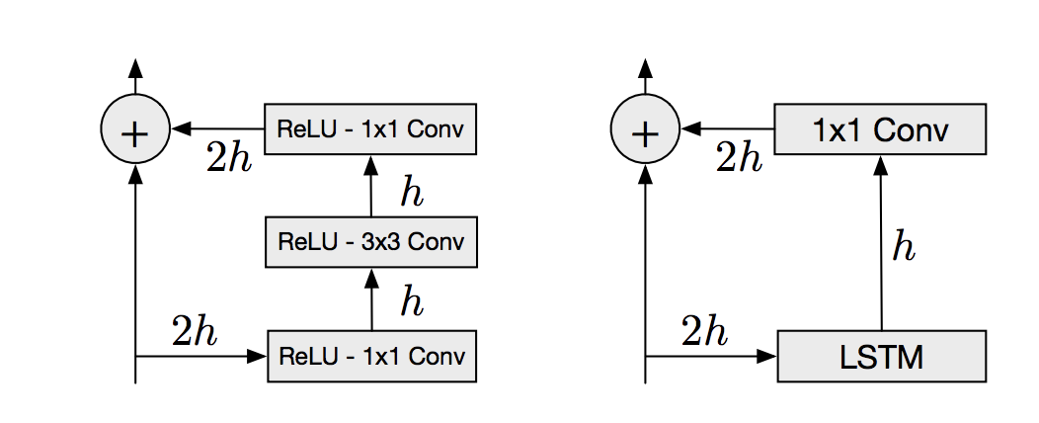
PixelRNN

Slide 4
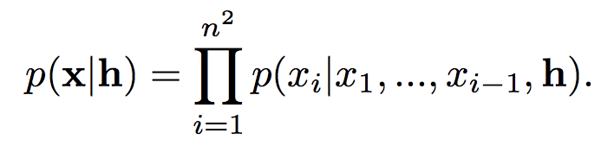
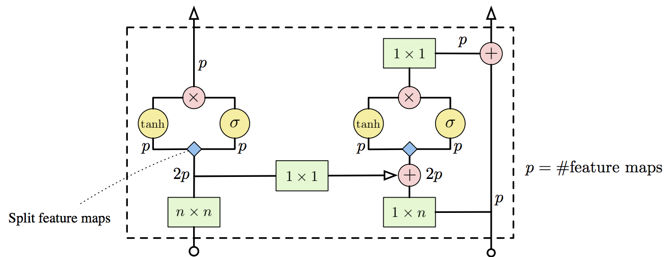

PixelCNN
A single layer in the Gated PixelCNN architecture. Convolution operations are shown in green, element-wise multiplications and additions are shown in red. The convolutions with Wf and Wg from are combined into a single operation shown in blue, which splits the 2p features maps into two groups of p.

Slide 5
WaveNet is structured

Slide 6
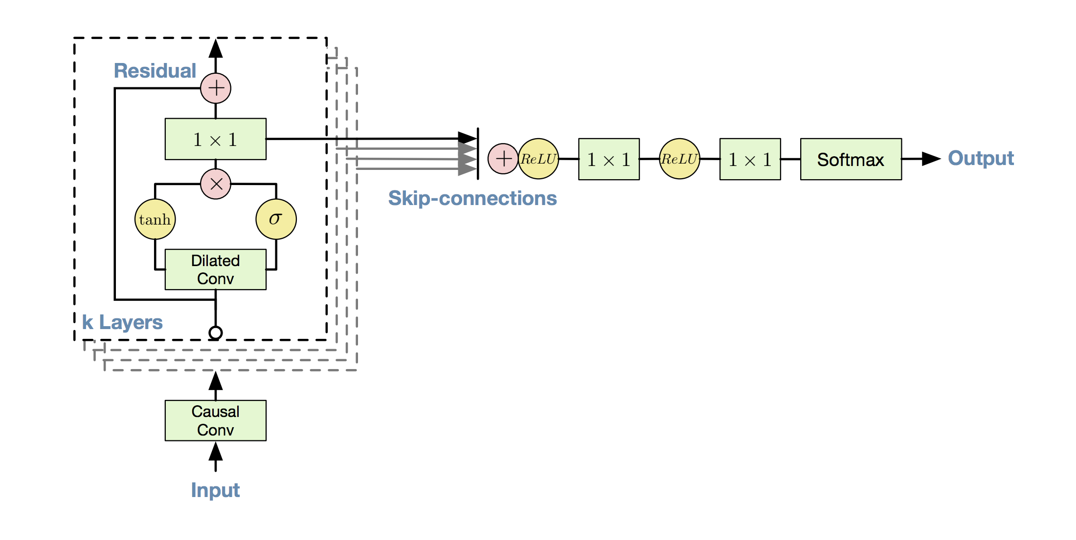
Overview of the residual block and the entire architecture.

Slide 7
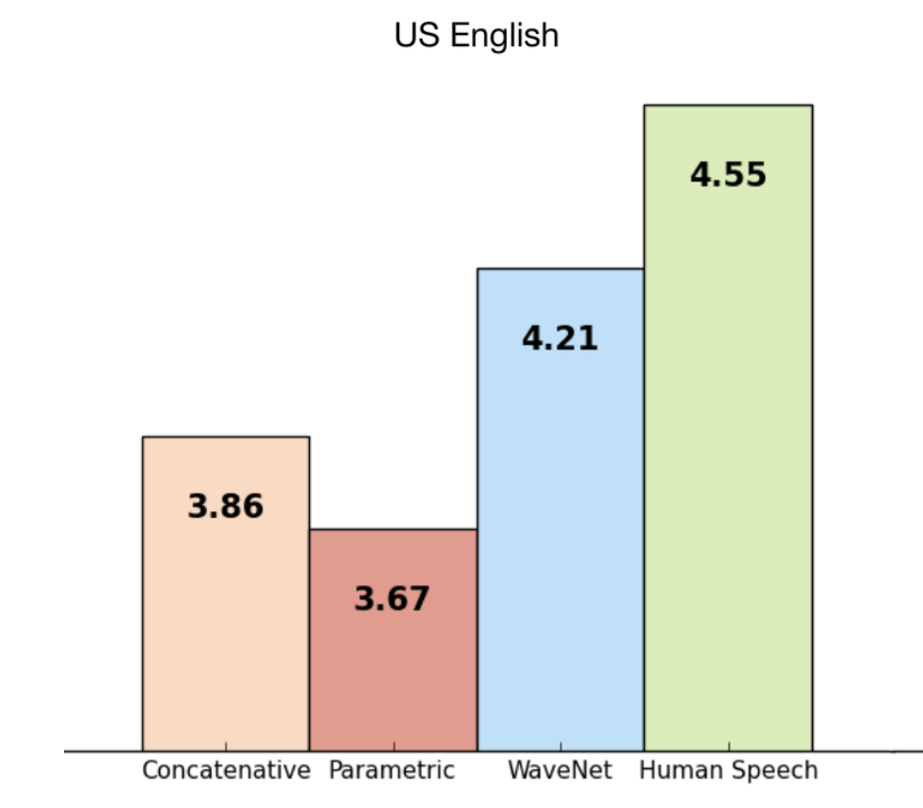


Comparison
Parametric
Concatenative
WaveNet

Slide 8
Knowing What to Say

Slide 9
Different identity

Slide 10
Generate music

Slide 11
Thank you for your attention!

